Slide 1
Digital Portfolio
STUDENT NAME: NEHAKUMARI.p
NMID: asunm161212401015
DEPARTMENT: Computer Applications
COLLEGE: Prince Shri Venkateshwara Arts & Science College

Slide 2
PROJECT TITLE
DIGITAL PORTFOLIO

Slide 3


AGENDA
Problem Statement
Project Overview
End Users
Tools and Technologies
Portfolio design and Layout
Features and Functionality
Results and Screenshots
Conclusion
Github Link
3/21/2024 Annual Review

Slide 4

PROBLEM STATEMENT
In today’s digital world, having an online presence is crucial for professionals to showcase their skills and achievements. Many graduates and developers rely only on resumes, which limits their ability to highlight projects, skills, and creativity interactively. Therefore, a personal portfolio website is needed to present skills, projects, and contact information in a visually appealing and professional manner.

Slide 5

PROJECT OVERVIEW
This project is a personal portfolio website designed and developed for Neha Kumari (BCA Graduate | Frontend Developer). It highlights academic background, technical skills, completed projects, and provides a way for potential employers, collaborators, or clients to connect. The portfolio is responsive, modern, and styled with a blue theme for a professional look.

Slide 6

WHO ARE THE END USERS?
The website is useful for: Recruiters & Hiring Managers → to assess skills and projects. Clients → looking for freelance frontend development work. Peers & Developers → to collaborate on projects. General Audience → to know more about the developer’s skills and work.

Slide 7

TOOLS AND TECHNIQUES
Frontend Languages: HTML5, CSS3, JavaScript Frameworks/Libraries: React.js (optional for future upgrade) Version Control: Git & GitHub Design Tools: Figma / Canva (for layout & design references) Deployment: GitHub Pages / Netlify / CodePen

Slide 8
POTFOLIO DESIGN AND LAYOUT
Header: Logo + Navigation Menu (About, Skills, Projects, Contact) Hero Section: Name, Title, Short Intro, CTA Button About Section: Brief bio with education and goals Skills Section: List of technical skills Projects Section: Cards for each project with title and description Contact Section: Email, GitHub link, and contact form Footer: Copyright and quick links
8

Slide 9
FEATURES AND FUNCTIONALITY
Responsive Design → Works on all screen sizes (mobile, tablet, desktop). Smooth Navigation → JavaScript smooth scrolling for section jumps. Contact Form → Allows visitors to send a message. Project Showcase → Displays multiple projects with details. Interactive UI → Hover effects and modern blue theme. GitHub & Email Integration → Direct access to repositories and communication.

Slide 10

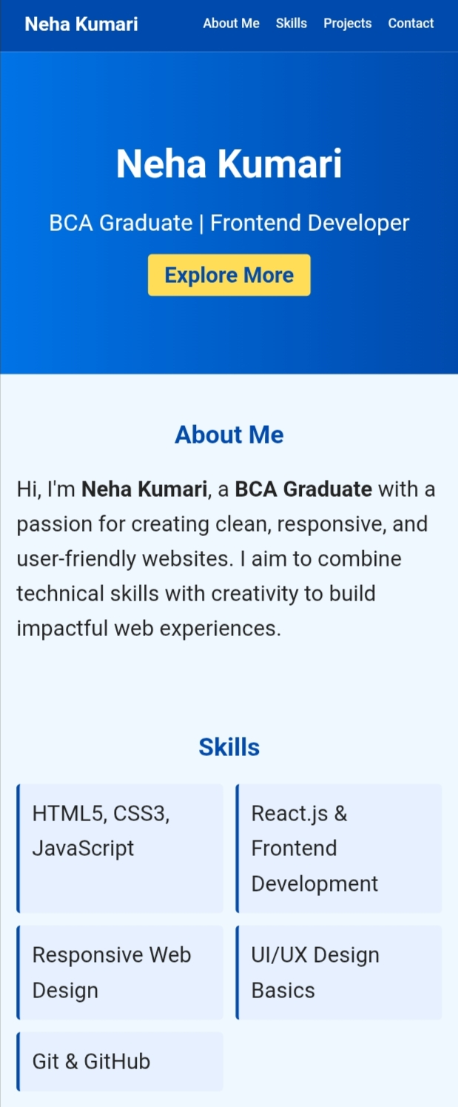
RESULTS AND SCREENSHOTS
A fully functional portfolio website hosted online. Enhanced personal branding and professional visibility. Easy access for recruiters and clients to connect. Scope for future improvements such as adding a blog, live project demos, or backend integration
3/21/2024 Annual Review
10

Slide 11
CONCLUSION
The portfolio successfully provides a professional online presence for Neha Kumari. It addresses the problem of limited exposure through resumes by offering a dynamic and visually appealing platform.
11

Slide 12
GITHUB LINK:-
github.com/neha28sharma8-create/nehakumari

